Slide 1
Analysis of Server logs data and strategic recommendations
Presented by
Munem Shariar Shams
BIS 581
Date: 11.23.2025
Notes:
Good Afternoon everyone. My name is Munem Shariar Shams and today I’ll be presenting my analysis of the server log data that the company provided me with and strategic recommendations based on the insights we gott from the analysis of that data.

Slide 2
Project Overview
What We Did:
Analyzed the usage of Virtual Desktop Infrastructure (VDI) in the year 2015.
Focused exclusively on VDI machine rather than all types of machines.
Analyzed usage patterns and user engagement patterns.
Assessed the quality of the data.
Listened to what the data is telling us and provided strategic recommendations based on the insights.
Why we did it:
To understand the significance of the VDI system for the students.
Data quality check ensures precise analysis. Bad data can never help us reach any good conclusions.
To uncover opportunities for growth and improvement.
To make data-driven decisions about resource allocation and operational cost management.
To leverage customer feedback for user experience improvement.
Notes:
Starting off with a brief overview of our analysis. What we did with this project is that we analyzed the usage of the VDI system in the year 2015 to understand what role this system is playing and how it’s helping us succeed with our academic missions. We focused only on the VDI machines for this analysis and we understood the usage and engagement patterns of the users. Obviously we had to asses the data quality before doing that because you know bad data can never help us reach any good conclusions. So we tried to listen to what the data is telling us and provided recommendations based on the insights so that we can make better decisions when it comes to resource allocation, operational cost management or just improving the overall experience for the users.

Slide 3
Data Preparation
Had to apply necessary filters from the large data set containing 3.1 million observations to include records only from the year 2015(299,998 records) and only for VDI machines. The final data set contained 227,386 records. Had to apply filters to fix date formatting issues for login and logout times.
Duplicate user IDs- There were 3013 unique users but there were multiple entries for any single users since they used multiple different apps in each session. We used n_distinct function to count users but did not filter out duplicate entries since it is important to understand app usage patterns. We cannot simply filter it out. The role of filters is to help us pull out what we want, not just make the data set smaller for us and do whatever is convenient.
Assessing the Data Quality- There were major flaws in the data quality which questions the credibility of the data such as wrong application stop times and wrong CPU usage values. I’ll point them out with clear examples.
Notes:
Before we jump to our analysis and recommendations I’ll take a quick minute to talk about our data preparation process. Obviously as I’ve mentioned before we filtered the data at first to only pull the records from 2015 which shortened the data set from 3.1 million to 299 thousand and then we applied a filter to only include records of VDI machines which further narrowed it down to 227 thousand. There were 3013 unique users but each user had multiple entries which led to duplicate user IDs since they use multiple different apps in each session. We didn’t filter that out because those entries are important for understanding application usage patterns. There were major flaws in the data as well which question the credibility of the data. I’ll point them out with examples now.

Slide 4
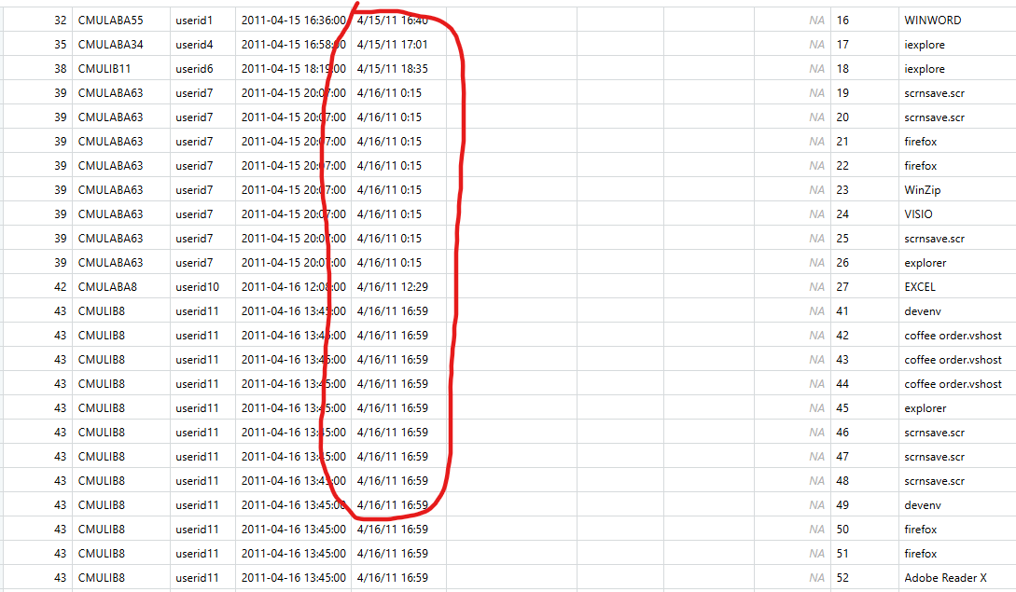
Wrong Date Format
Notes:
Moving on to examples. Here’s the wrong date format

Slide 5
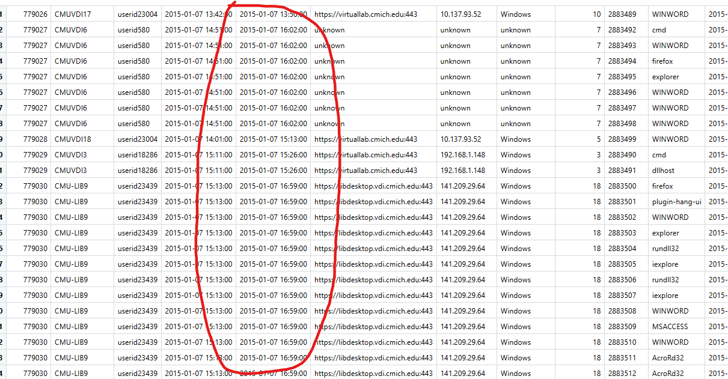
Fixed Date Format
Notes:
Here’s the fixed one

Slide 6
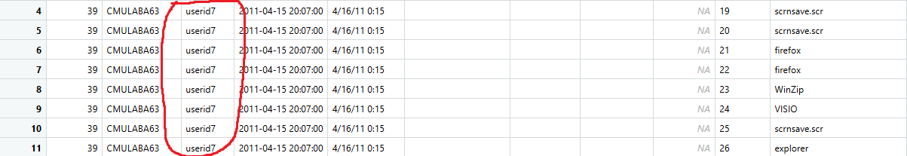
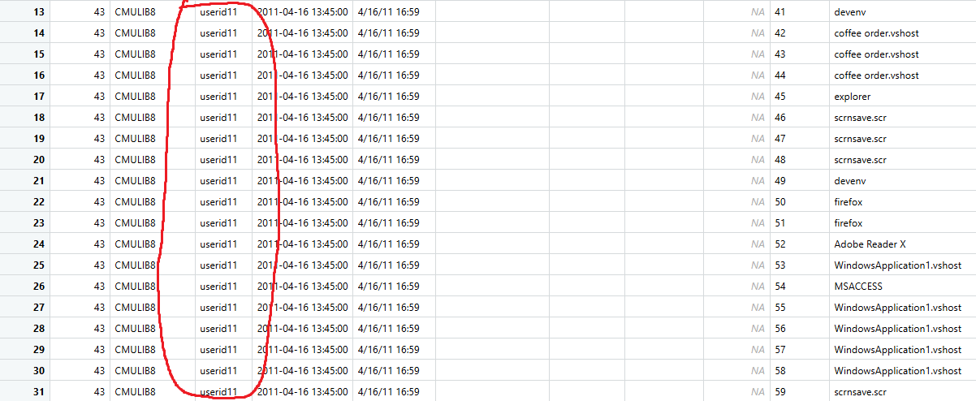
Duplicate User IDs
Notes:
Here’s an example that shows the duplicate user IDs.

Slide 7
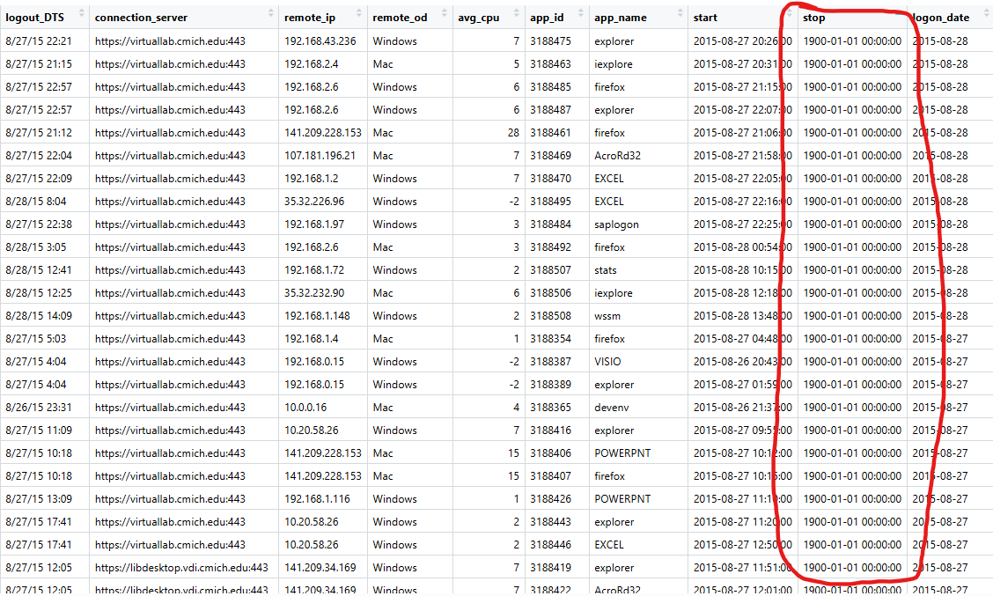
Wrong Stop time data for applications (1900-01-01)
Notes:
The wrong application stop time data

Slide 8
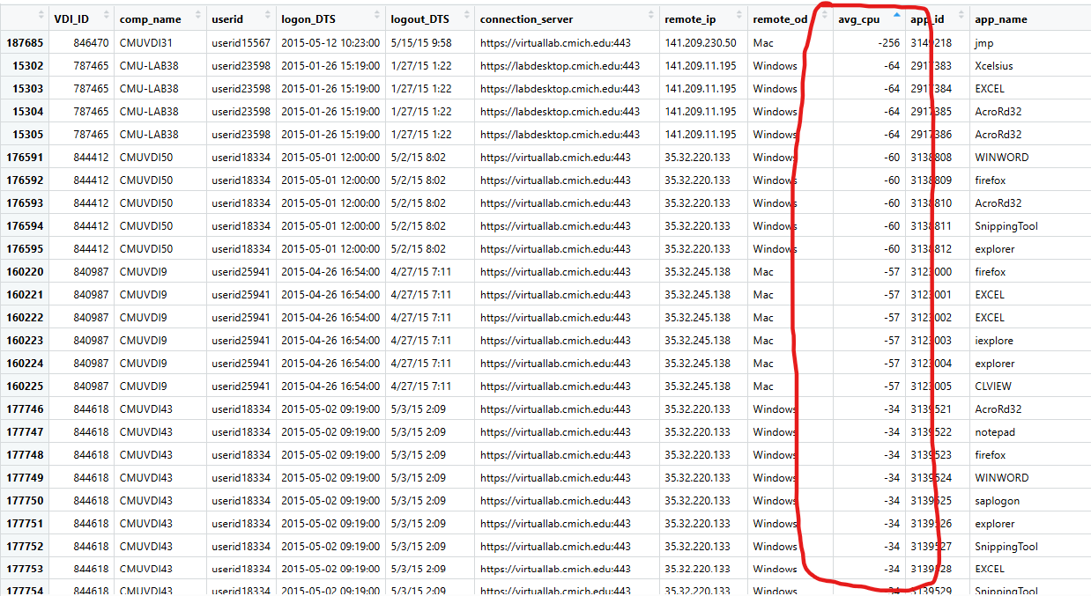
Wrong CPU Usage data (Negative Values)
Notes:
And the wrong CPU usage data which contains negative values.

Slide 9
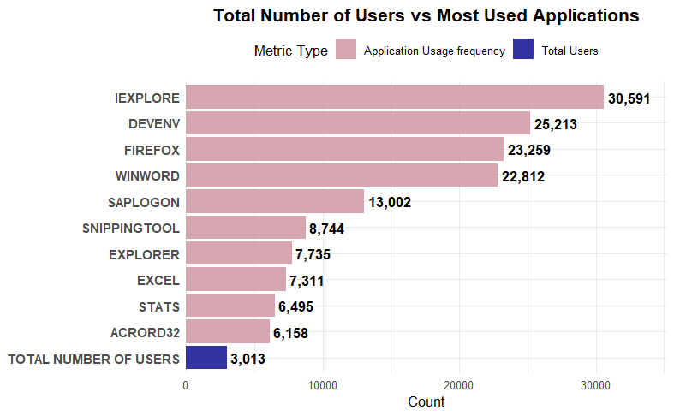
Analysis of Overall USAGE
Total Number of Users:
Total 3013 users in 2015
Each user uses an average of 5 different applications per session
An overview of some of the most used applications.
Notes:
Moving on to our analysis of the system’s usage. There were 3013 unique users in 2015. And on average each user uses 5 different apps per session. I hope this bar chart gives us an understanding the usage frequency based on the usage of the most used applications.

Slide 10
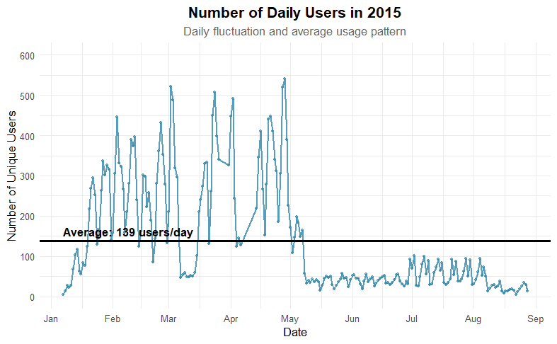
Analysis of Overall USAGE
Average Number of Users:
An average of 139 users per day. Median was 62.
Extremely low traffic in the Summer.
This suggests that resource allocation should be done accordingly.
Notes:
The average number of users per day was 139. However the median number was 62. This difference is due to the massive fluctuation in both the seasons and the days of the weeks. So We can see in this graph that there is a massive decline is traffic during the Summer. The number of users per day is way lower than the average during the Summer. Let’s move on to analyzing that traffic based on each day of the week.

Slide 11
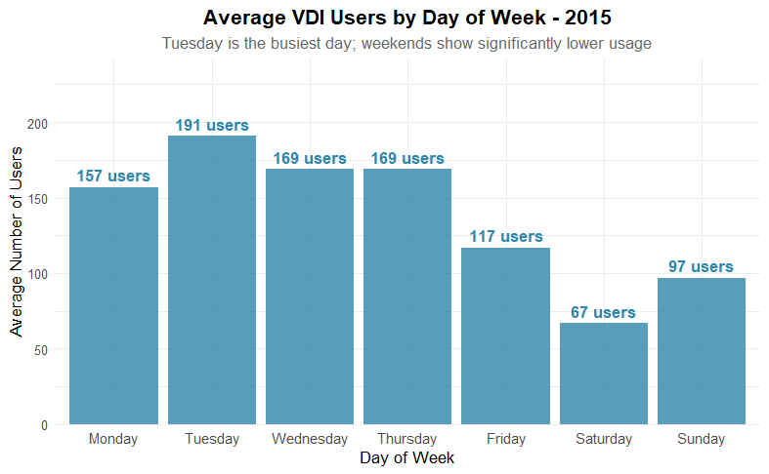
Analysis of Overall USAGE
Average Number of Users:
Tuesday was the peak day with an average of 191 users.
Usage remained high on Monday (157) and Wednesday (169) and Thursday (169).
A noticeable decline occurred on Friday (117).
Weekend usage was less than half of the weekday usage, with Sunday (84) and Saturday (71) seeing the lowest traffic. So the traffic declined more than 50% on weekends.
Notes:
As we can see there’s a noticeable decline on Friday right before the weekend and then on the weekends obviously the traffic is lower than weekdays.

Slide 12
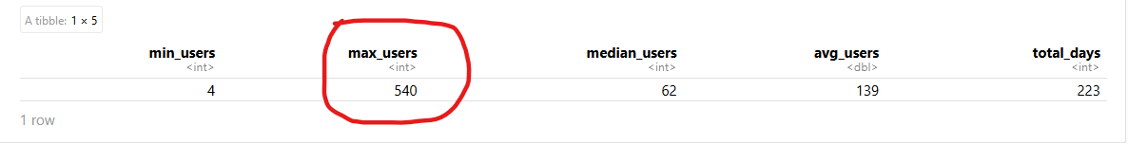
Analysis of overall usage
Highest number of Users on a single day was 540 on April 28 (Tuesday)
Notes:
The highest number of users on a single day was 540 on April 28th which was a Tuesday. Moving further along with that,

Slide 13
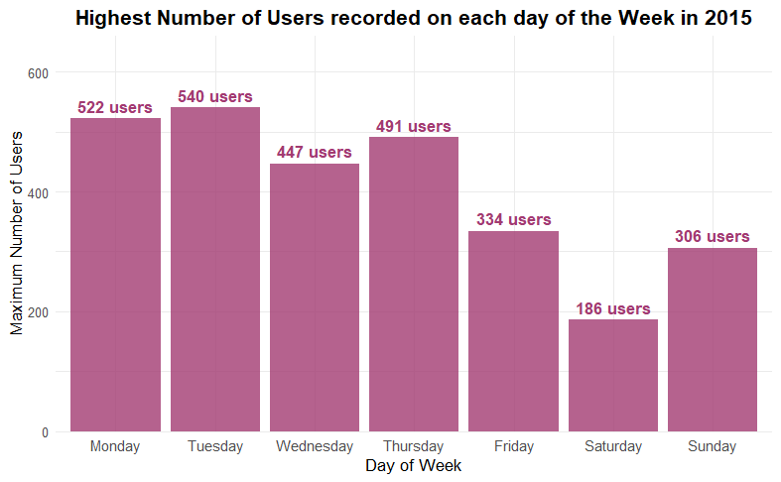
Analysis of Overall USAGE
Highest Number of Users:
This chart shows us the highest number of users based on each day of the week.
There’s a resemblance to the weekly chart for average number of users for Friday and the weekened.
Notes:
This chart right here shows us the highest number of users based on each day of the week. With resemblance to the other weekly chart that we had about the average number of users, the highest number also declines steadily on Friday leading on to the weekend with the lowest traffic in the week. There’s an obvious resemblance in the pattern.

Slide 14
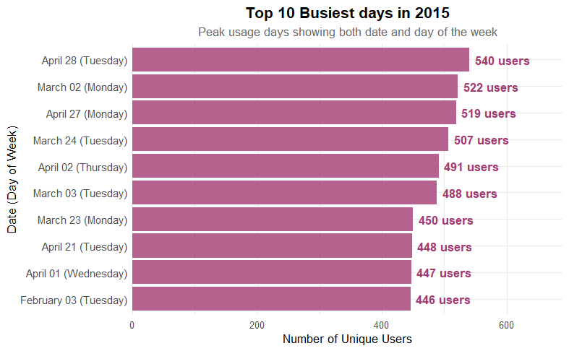
Analysis of Overall USAGE
Highest Number of Users:
Strong concentration in the Spring semester which is a regular academic session and Summer is not.
8 of the 10 days falling on a Monday or Tuesday.
This clustering of peak usage days suggests that the beginning of the week is when demand is highest.
The maximum users by day of week further confirms this pattern.
Notes:
We also analyzed the top 10 busiest days of the year and this also shows more resemblance to the pattern that we established. 8 out of 10 days are either Mondays or Tuesdays. None of them are Fridays or Weekend days. So there’s a pattern and we have more than enough evidence to prove it.

Slide 15
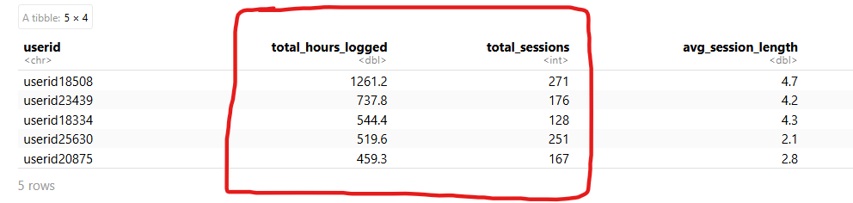
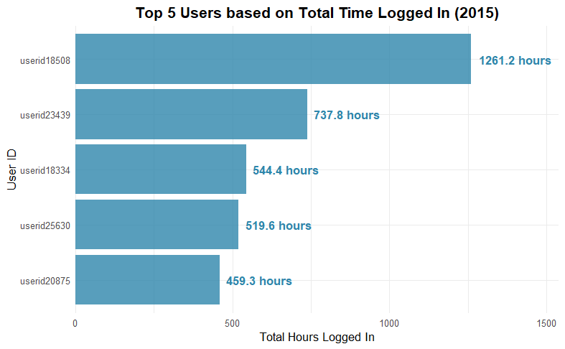
Analysis of the top 5 users
Customer Favorites
These users represent the system's "power users" with the top user averaging 4.7 hours per session over 271 separate logins, indicating a high dependency on VDI usage.
Notes:
Moving on to our analysis of the top 5 users and their average CPU usage. So as we can see here these users represent the power users of our system and the top user averages 4.7 hours per session across 271 separate sessions.

Slide 16
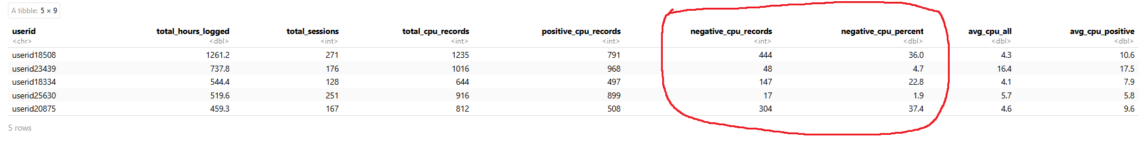
CPU Usage of the TOP 5 Users
As noted in the data quality section, the CPU usage data contains significant issues. We already know that 5.88% (total 13,371) of the entries are negative in this column which is a data quality issue since CPU usage percentage cannot be negative. This affected our analysis of the average CPU usage of the top 5 users as well. So, for this section we conducted two separate analysis, one with the given data which contains negative values and one with a filtered data set with only positive values.
Notes:
As I have mentioned before the CPU usage data had 13 thousand or 5.88% negative values and it affected our analysis here. The CPU usage data of these 5 users also had negative values as we can see here.

Slide 17
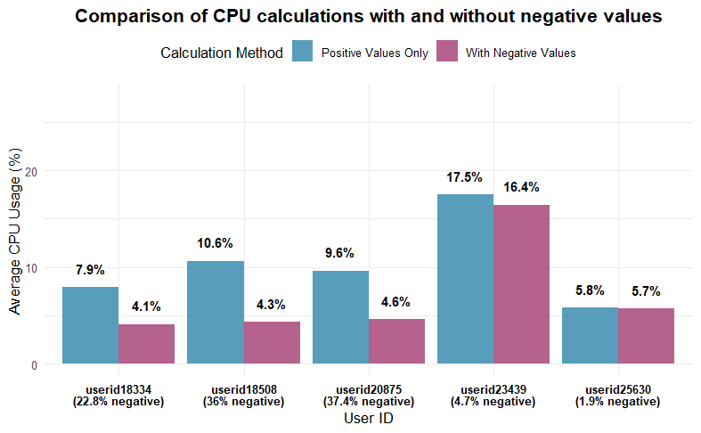
Cpu usage of the top 5 users
So, for this section we conducted two separate analysis, one with the given data which contains negative values and one with a filtered data set with only positive values.
Notes:
So, for this part of our work we conducted two separate analysis, one with the given data which contains negative values and one with a filtered data set with only positive values.

Slide 18
Strategic Recommendations
Implement dynamic scaling during summer months to reduce resource allocation by 40-50%, potentially saving thousands in operational costs
Identify and recruit the top 5 users for a beta testing program to gather qualitative feedback and improve system features.
Move all system maintenance to weekends when usage drops by more than 50%, minimizing disruption to academic activities.
Improve data collection and focus on the improvement of data quality for the future.
Allocate 25% more resources for peak usage weekdays.
Develop seasonal staffing models aligned with academic calendar. Regular staffing is not needed during the Summer due to significantly low user traffic.
Develop specialized training for high-engagement applications. These aren’t needed for the basic applications like internet explorer or Microsoft Word but for the more advanced or technical applications like Visual Studio or SAP.
Create a quick start guide for infrequent users (555 one-time users).
Notes:
Now to the important part, My concluding recommendations. Firstly I would like to suggest dynamic scaling based on the massive fluctuation noticed in the usage pattern. During the Summer we should reduce resource allocation by 40-50% and this could potentially save us a lot of money. We could consider the top users for a beta testing program for improving our system features. We should always ensure that maintenance work is scheduled on weekends and never on weekdays based on our usage patterns from this analysis. We should ensure proper data collection because we noticed a lot of bad data in the data set that was provided to us for this project. We should allocate resources based on the results we got, based on the traffic and the usage patterns and that includes staffing in our facilities. We obviously don’t need the regular staffing during the Summer due to the low usage. We could start working on training programs for the applications that are a little bit more on the technical side. Obviously we don’t need training programs for internet browsers of Microsoft word but there are programs like Visual Studio or SAP which are some of the top used applications and we can develop training programs for those. Similarly, we can also develop a quick start guide for new users. We noticed 555 one time users among the 3013 users in our system.

Slide 19
Thank you
Notes:
That will be all for today but if anyone has any questions please feel free to reach out to me. Thank you!

